Slide 1
Fuzz Testing – Perform Testing
AVCDL-Implementation-10.1.3
Charles Wilson
Staff Product Cybersecurity Architect
version 2
2026-06-22
Notes:
Script:
I'm Charles Wilson, staff product cybersecurity architect at Torc Robotics.
This presentation will cover the Fuzz Testing – Perform Testing activity.

Slide 2
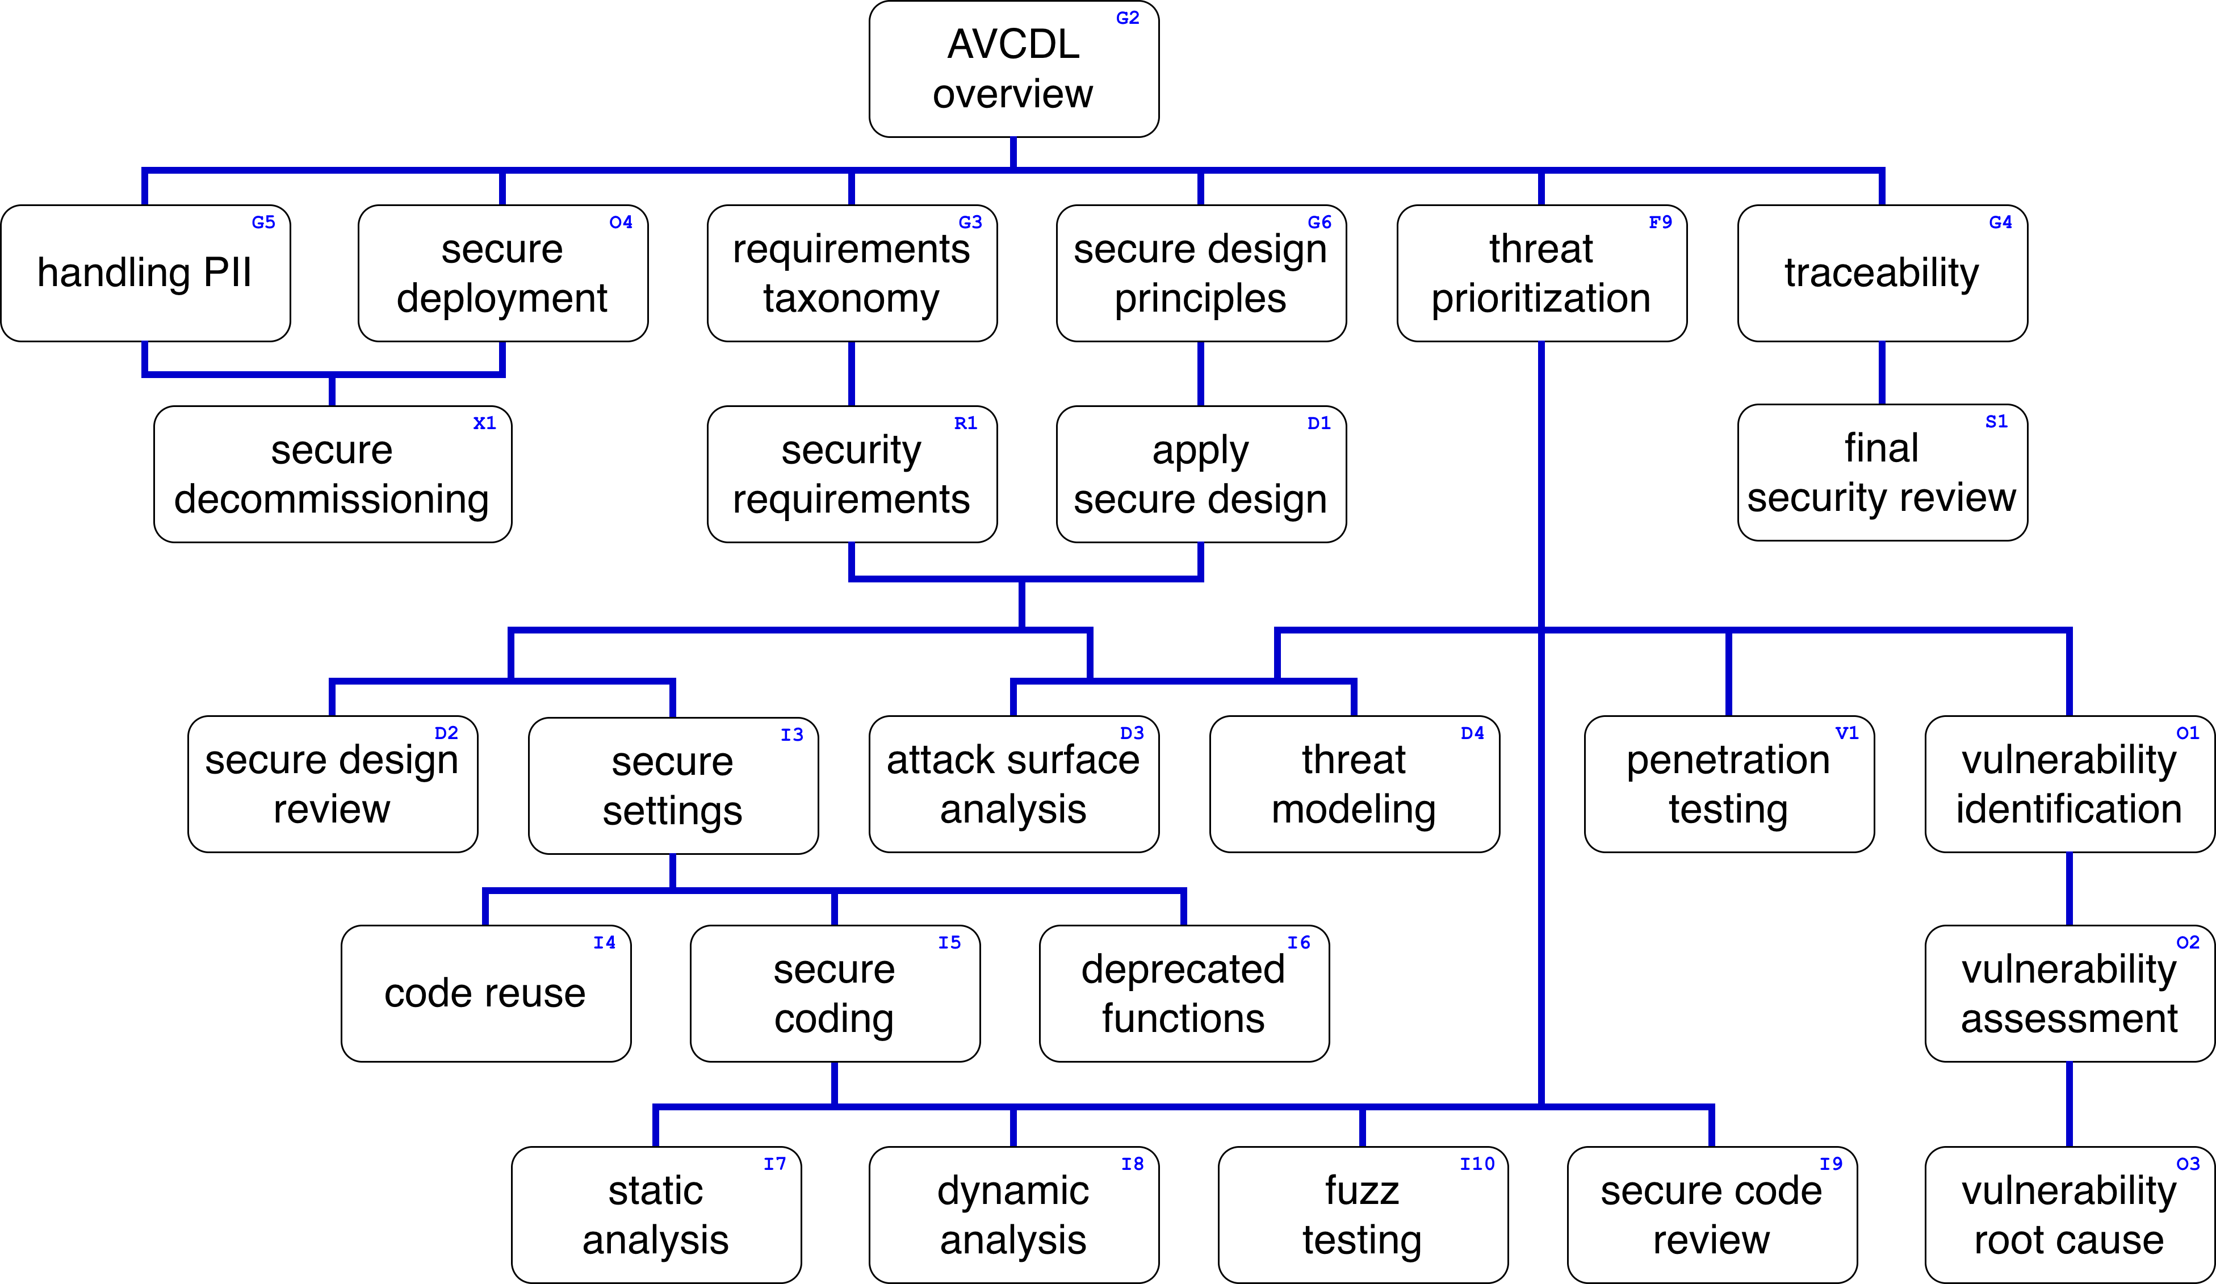
Training Path
Notes:
Script:
This diagram shows the overall AVCDL training path.
If you're taking this training, it's assumed that you've already completed the AVCDL Overview training,
and additionally, that you've completed the
Requirements Taxonomy
Security Requirements
Secure Design Principles
Apply Secure Design
Secure Settings
Fuzz Testing Overview
Fuzz Testing – Establish Settings
and
Fuzz Testing – Create Test
trainings.
This training will cover the Fuzz Testing – Perform Testing activity.

Slide 3
Workflow
Notes:
Script:
Before getting into how we handle the perform testing activity, let's briefly review where it fits in the overall fuzz testing process.

Slide 4
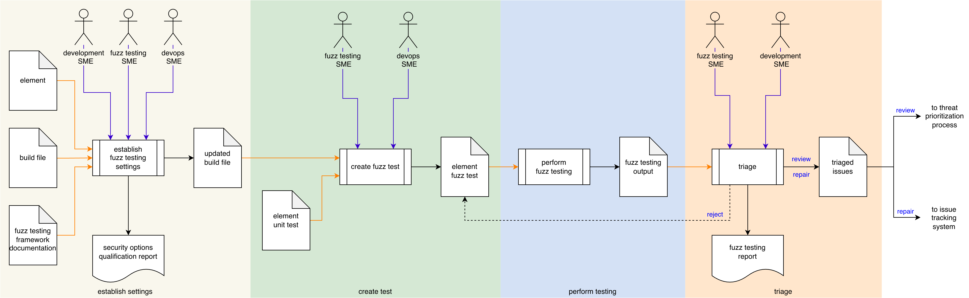
Process Workflow
Notes:
Script:
Here's the fuzz testing process which we previously covered in the Fuzz Testing Overview training.
[break]
Our focus for this training will be on the third activity, that of performing the test.

Slide 5
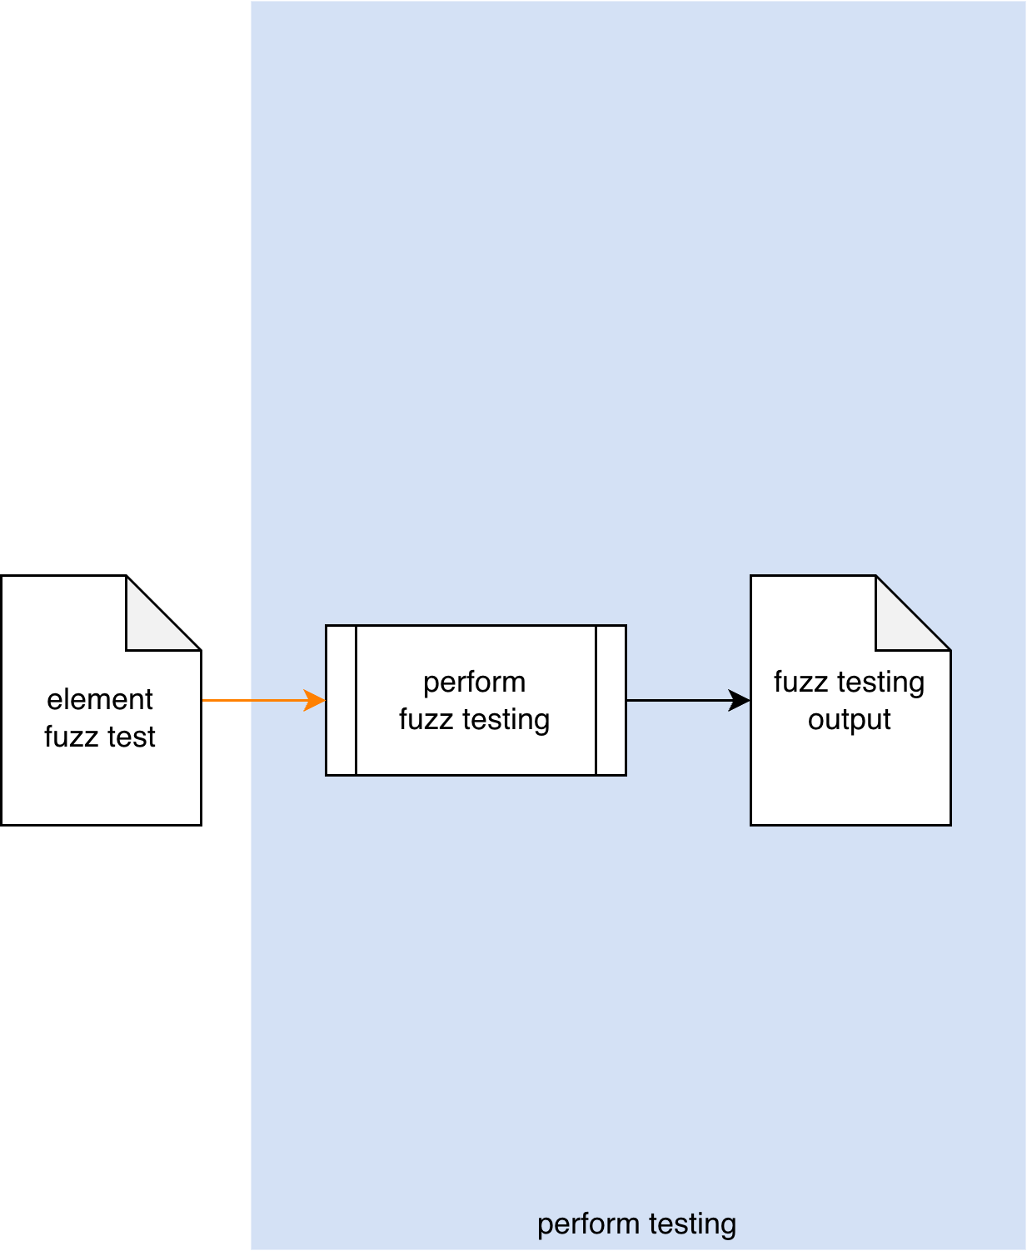
Process Workflow
Notes:
Script:
Here's the fuzz testing process which we previously covered in the Fuzz Testing Overview training.
[break]
Our focus for this training will be on the third activity, that of performing the test.

Slide 6
Perform Testing Activity
Notes:
Script:
In the perform testing activity, the build system invokes
[pause]
the element fuzz test,
[pause]
which performs the fuzz testing and generates
[pause]
a fuzz testing output file.
[pause]
Ideally, this is done in the context of the CI/CD pipeline without the need for human intervention.
Even though this activity is shown without an explicit actor, that doesn't mean that it isn't possible for someone to invoke the tooling locally.
This is true with all automation.
We shouldn’t automate an activity until we can perform the task manually.
[pause]
And as a reminder, the preferred form of the output is
[pause]
JSON-encoded SARIF, which allows for uniform handling of cybersecurity relevant information as it passes through the CI/CD pipeline.

Slide 7
Perform Testing Activity (overlay)
JSON-encoded SARIF
Notes:
overlay

Slide 8
Runtime Considerations
Notes:
Script:
Given that we've stated that fuzz testing is a fully automated activity, one might wonder what possible considerations there may be.
[pause]
Even given its automated nature, there are still concerns worth considering.
Let's look at those.

Slide 9
Considerations
Termination on Error
Issue Occlusion
Cybersecurity Side-effects
Notes:
Script:
Our first consideration is that of
[pause]
termination on error.
It's not uncommon for this type of testing to cause an application to terminate.
This has been mentioned multiple times within the fuzz testing materials but is worth repeating here.
You can't just add a fuzz test, which is going to be generating random inputs, and assume that everything is going to go smoothly, especially when it's used in conjunction with dynamic analysis frameworks to detect anomalous behavior.
Regardless of whether a test terminates on error or not, it’s critical that you handle its behavior in a way that allows the CI/CD pipeline to continue to its next task.
This includes cleaning up any residual state that remains after the test completes.
[pause]
Our next consideration is that of
[pause]
issue occlusion.
When an issue is detected, it's important to establish that it's not masking more fundamental issues.
Review the test results carefully and don’t just stop when you get the first failure.
[pause]
Finally, it's important to remember that fuzz testing may have
[pause]
spillover effects that trigger other cybersecurity tooling in use.
Make sure that within the context of fuzz testing that other cybersecurity tests that are not explicitly supporting fuzz testing are turned off or otherwise flagged so that they won't be generating false positives related to the element under consideration to which we're applying the fuzz test.

Slide 10
Recap
Notes:
Script:
That covers the perform testing activity of the fuzz testing process.
Let's look at a summary.

Slide 11
Summary
Consider the build system impact
Use SARIF for output
Notes:
Script:
There are two main points to keep in mind when you're performing fuzz testing.
First,
[pause]
always consider the build system impact of the activity.
It can't be overstated that any disruption to the build system has a severe impact on the velocity of the development teams, so it should be a priority to ensure that there is sufficient resource headroom for fuzz testing to be performed without exceeding the allocated time and space budgets.
Also ensure that any negative impacts of the test are accounted for, whether these be termination or anomalous behavior.
[pause]
Second,
[pause]
Use SARIF for output when it's feasible.
This is because it’s both readily processed by Python, enabling easy intake by the issue tracking system, and can also be used as feedback directly into various IDEs to facilitate mitigation by the developers themselves.

Slide 12
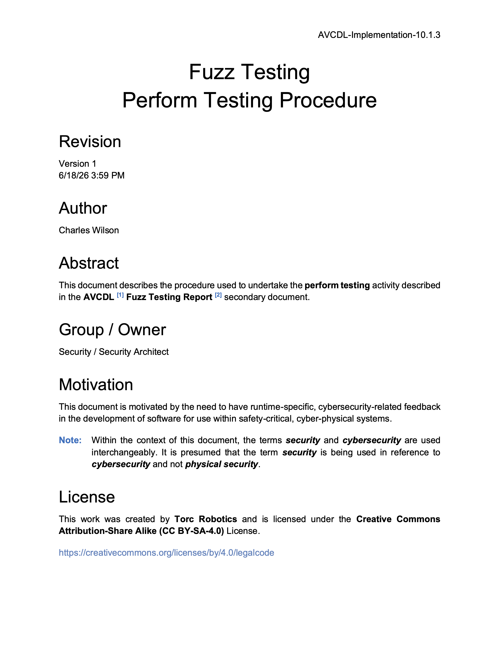
Further Reading
Notes:
Script:
For additional information and to get a more in-depth set of references, the Fuzz Testing – Perform Testing Procedure tertiary document is available in the AVCDL GitHub repository.

Slide 13
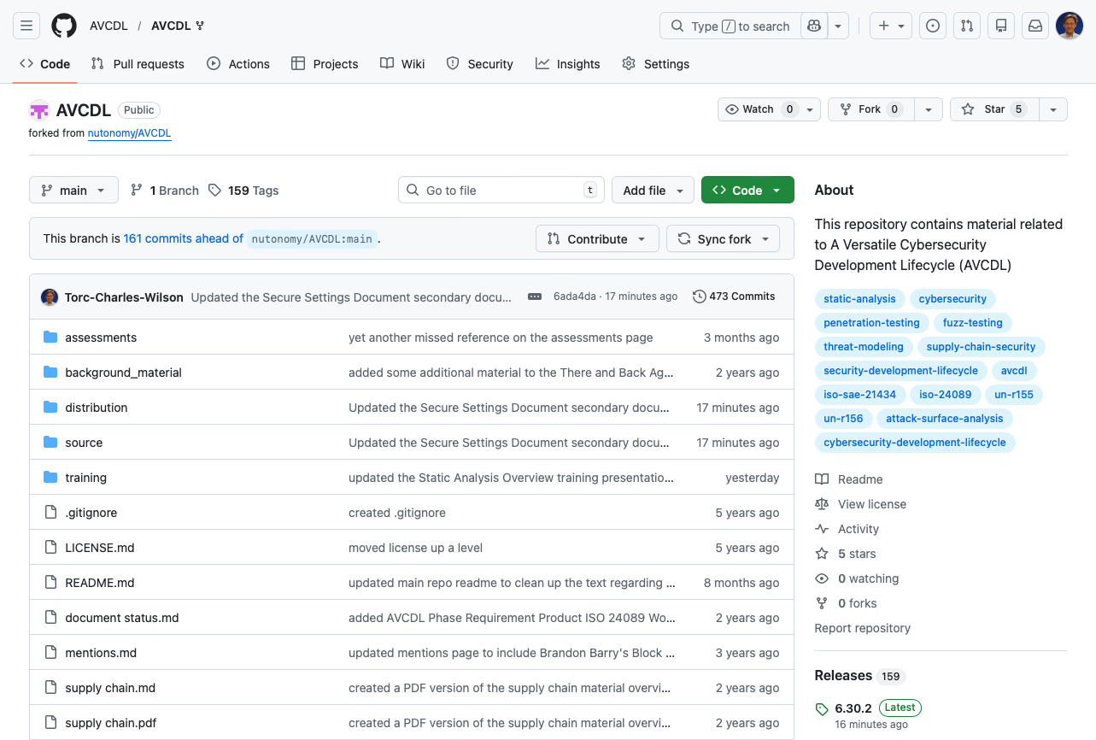
AVCDL on GitHub
https://github.com/AVCDL/AVCDL
Notes:
Script:
All AVCDL materials, both in source and distribution forms, are available on our GitHub site, as shown here.
Because of the size of the repository, it's recommended that you either clone the repository or download a ZIP archive of it, if you're not familiar with using git.
Instructions for downloading a ZIP archive are linked to on the repository’s front page.

Slide 14
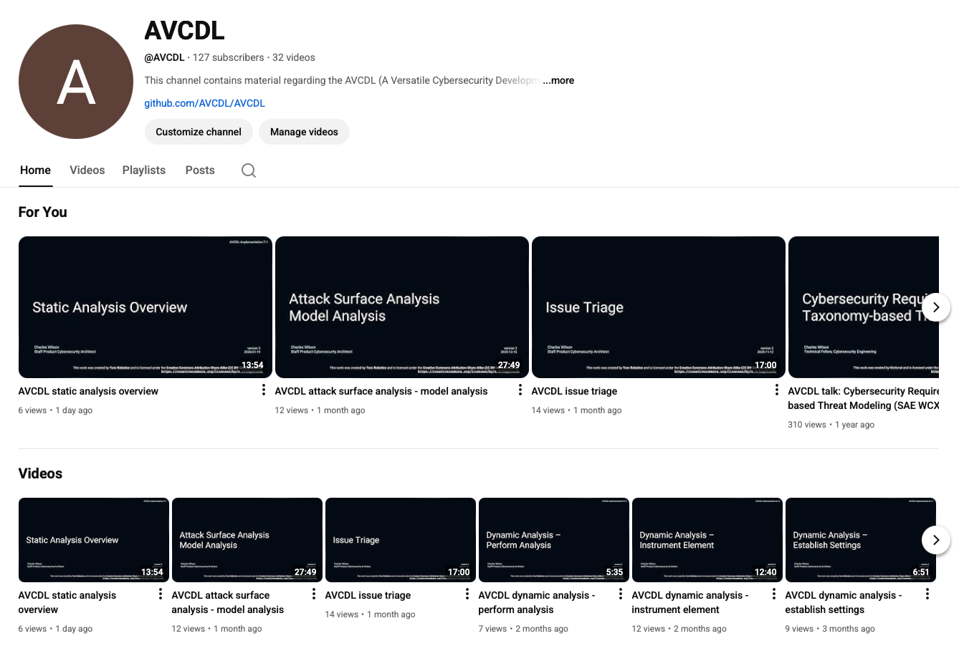
AVCDL on YouTube
https://youtube.com/@AVCDL
Notes:
Script:
Videos covering various aspects of the AVCDL are available on our YouTube channel, as shown here.
It's important to note that all AVCDL materials with the exception of the introductory blog posts are intended for product cybersecurity engineering practitioners.

Slide 15
Next Steps
Notes:
Script:
With this training complete, if you’ve completed the other trainings covering the Fuzz Testing process activities, you can proceed to the other trainings at this level, these include:
Static Analysis
Dynamic Analysis
and
Secure Code Review

Slide 16
References
AVCDL primary document
Fuzz Testing Report (AVCDL secondary document)
Fuzz Testing – Perform Testing Procedure (AVCDL tertiary document)
Static Analysis Results Interchange Format (SARIF) Version 2.1.0
https://docs.oasis-open.org/sarif/sarif/v2.1.0/os/sarif-v2.1.0-os.pdf
Notes:
Script:
Here are the references to the source material used in the creation of this presentation.
They'll also be included in the video description.
Additionally, this presentation’s source material will be provided on the AVCDL GitHub repository.

